Slide 1


Alpha Phi Omega
Chi Chapter at UCLA
Alpha Mu / Kay Krenek Term, Meeting 7
December 3, 2014
www.apo-x.org

Slide 2
Agenda - Estimated Time End: 8:15
1. Officer Updates and Announcements
2. State of the Chapter Open Floor Discussion
3. Alpha Nu Nominations Part I
4. Namesake for Alpha Nu Term
5. Last Announcements

Slide 3
President
Raymond Mai
president@apo-x.org
Executive Committee
excomm@apo-x.org

Slide 4
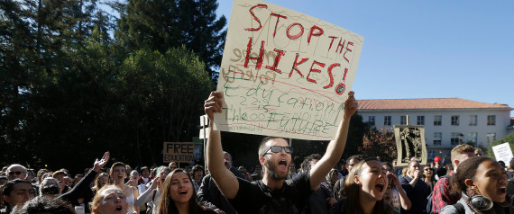
Tuition Hike Update
USAC voted to express “No Confidence” in UC President Napolitano
This severely damages her reputation
Alternatives to the tuition hike proposed:
Cutting the Middle-Class Scholarship to prevent hike
Accrediting certain Community Colleges with the ability to offer Bachelor Degrees

Slide 5
Leadership Workshops
January
Joseph Chan
Building a Community
Raymond Mai
Investment Banking
Excomm
Excomm 411
Excomm Transition
USAC EVENTS TOO!

Slide 6
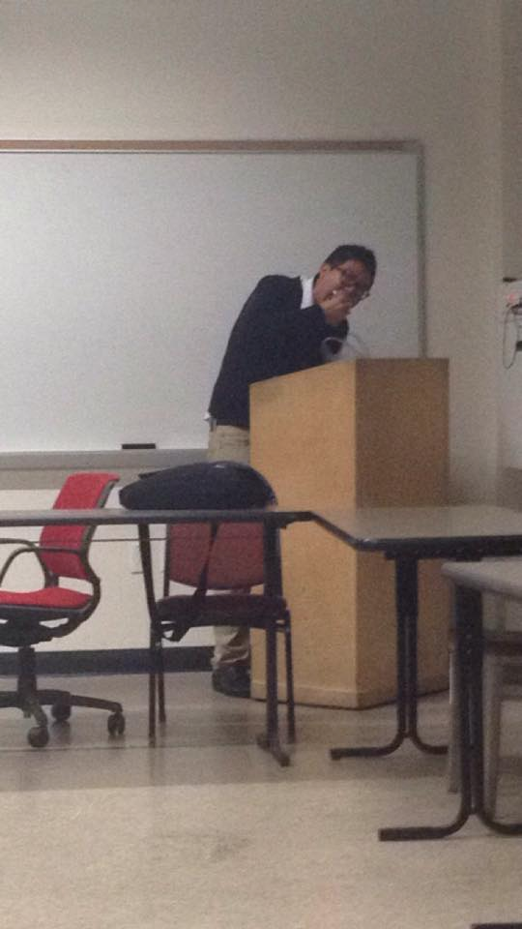
[L] Finding a Purpose in APO
THANKS FOR COMING OUT YESTERDAY!
20+ people!

Slide 7

Mental Health Awareness
Financial Concerns
If you are facing financial concerns, be sure to visit:
http://www.usac.ucla.edu/fsc
We have financial resources and guides!
How to Budget
First Credit Card Guide
iClicker Loan Library, Textbook Scholarship, Parking and Transportation Scholarship, Lab Coat Loan Library

Slide 8
Timeline of Elections
Today, CM7: Nominations Part I
Next Week, CM8: Nominations Part II
Advisor Elections: Jessica Suhardjo
January 7th, 2015, CM9: Elections Part I
President to Pledge Parents/Finance VPs
January 14th, 2015, CM10: Elections Part II
Finance VPs/Fellowship VPs to CAC
January 21st, 2015, CM11: Namesake Elections
Doesn’t count as an “Elections Meeting” in terms of getting meeting credit

Slide 9
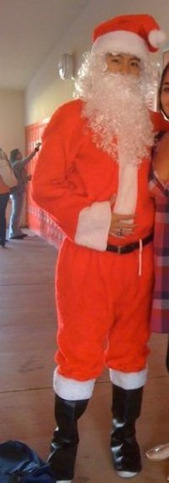
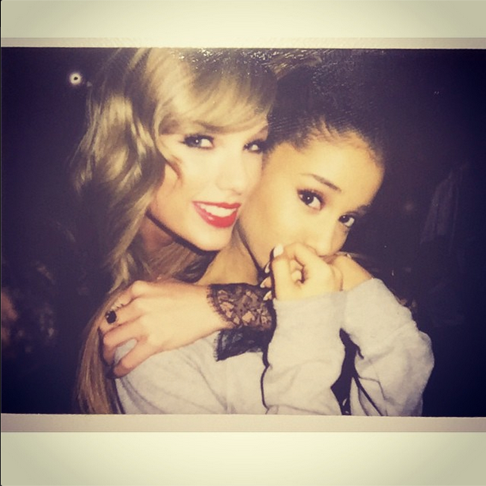
COUPLE OF THINGS
Baebaes Taylor Swift and Ariana Grande will be on the Victoria Secret Fashion Show next Tuesday #Bruh
PICK UP YOUR TRASH. ESPECIALLY TODAY.
HOLIDAY SEASON IS COMING YAHHHHHH.
My door is open if you EVER need to talk

Slide 10
Administrative VPs
Kevin Quizon & Nicola Yip
admin@apo-x.org

Slide 11
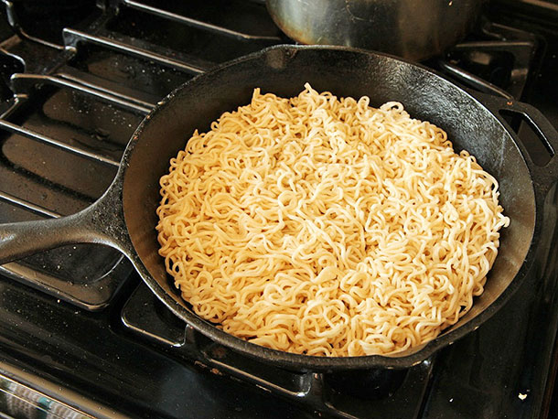
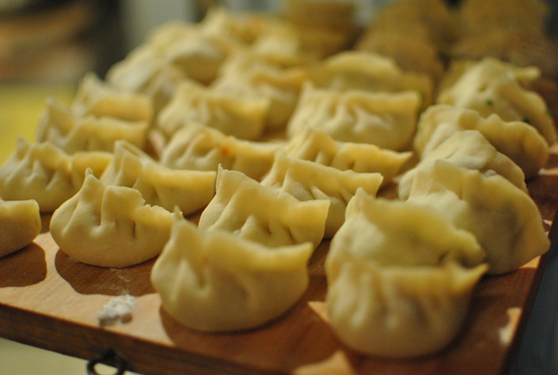
[FEL] Alumni Potluck on Sunday @ 6pm!

Slide 12
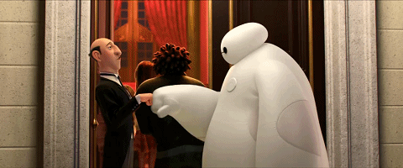
Alumni Mentorship
Pairings have been sent out! Check your e-mails!

Slide 13
MEMBERSHIP.
Jeremy Gozzip & Andrew Suh
membership@apo-x.org

Slide 14
Big Appreciation!

Slide 15
ALPHA ETA
AH

Slide 16
Brian Tea

Slide 17
Achievements!
Bring them points in APO!
Work with your fam heads to become the family of the term!

Slide 18
BUY FAM SHIRTS!!
$6 per shirt
Cash & Venmo~

Slide 19
Service VP
Rui Guo
apoxservice@gmail.com

Slide 20
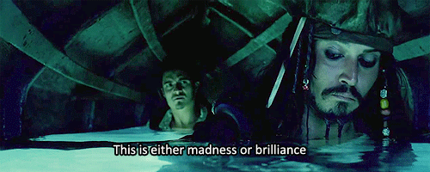
MPA Watch
Email the coordinator if you want to attend!
However, events may be cancelled due to rain :(

Slide 21


Got Hours?
Need service hours!? Make blankets and care packages!
We will be donating these to kids for the Christmas holidays!
Look out for an email for more details!

Slide 22

Disneyland?
2:30 am Thursday night/Friday morning
Disneyland tickets
NOT CONFIRMED
We still need 50 people, if you
are no longer interested,
please let me know!

Slide 23

Pledge Parents
Brian Lee & Emily Neai-Proeung
apoxpparents@gmail.com

Slide 24
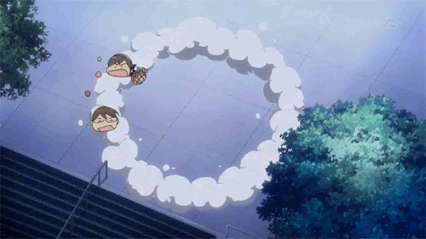
Protect the Pledge Parents/President
“[A]lways [M]oist” - Moist Melissa Ma (MMM)

Slide 25
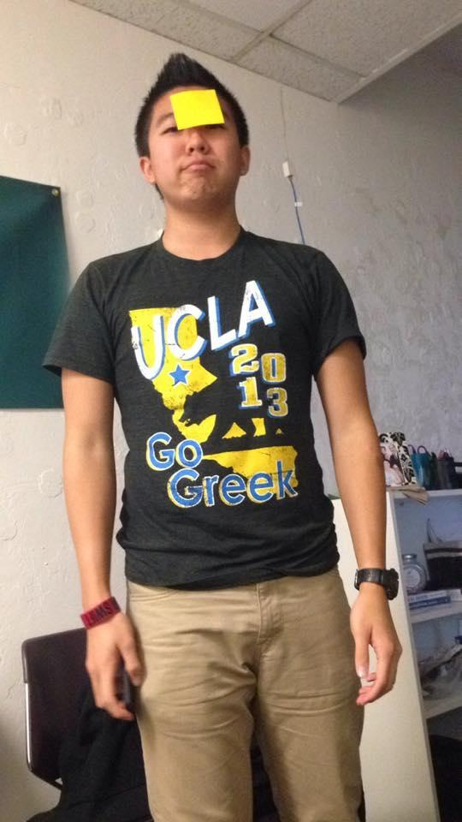
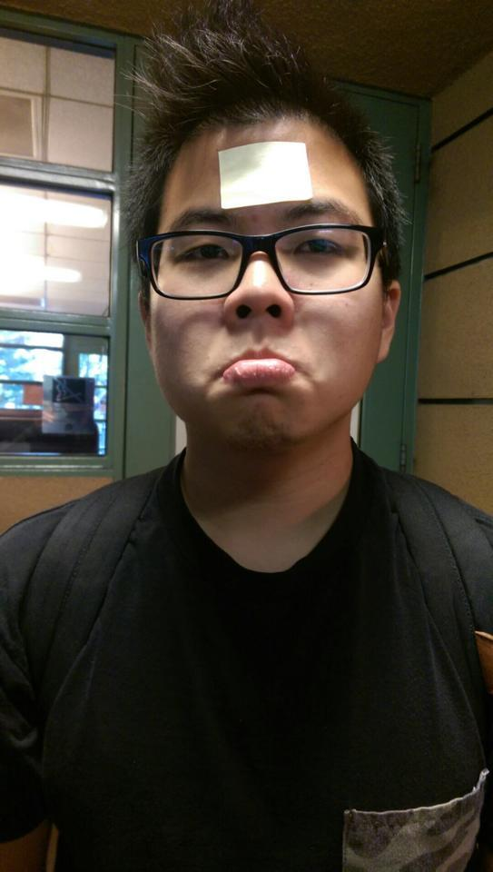
Protect the Pledge Parents/President
APO Abruham Lincoln/JFK :^(

Slide 26
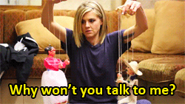
Interviews
8 Active Interviews!
Also, let us know ASAP if you wish to be removed from the Required interview list!

Slide 27

Interviews
Please respond to your e-mails if you wish to remain on the required interview list!

Slide 28



Quizzes/missions
Quiz: Scout Oath, Scout Law, and National/Chi Chapter History
Missions: Big/Lil Service due CM #8

Slide 29
Possible Activation Date
Possibly moving Activation from Monday (1/19) to Tuesday (1/20).
ABSOLUTELY MANDATORY EVENT
We need 100% compliance from the pledge class in order to switch it.

Slide 30
Finance VPs
San Li & Jonathan Liu
finance@apo-x.org

Slide 31
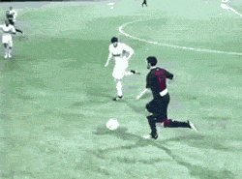
$$$$$$$$$$$$$
Sorry I have laryngitis so I can’t speak
Actives pls pay me your last installment after meeting (ask me if you don’t know how much)

Slide 32

TV Taping - Sat. Dec 13.
America’s Funniest Videos
Currently 22 people
Enough rides for 30 people to go!
Estimated pay out is $18-20 per person

Slide 33
Charities - Let’s vote!
American Foundation for Suicide Prevention
Brain & Behaviour Research Foundation
Treatment Advocacy Center

Slide 34
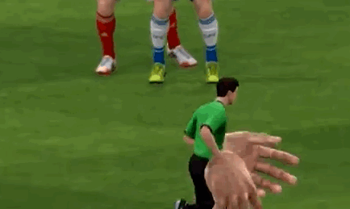
Fundraisers
Let us know if you want any fundraisers put up!
Look out for a FIFA tournament against me (winter quarter), I’m going to win it but regardless come out for fundraising & fun!

Slide 35
Fellowship VPs
Ann Dai & Danny Ly
fellowship@apo-x.org

Slide 36

Funfoursies Part 2
We sent out the E-mail already!!!
It’s due Next Wednesday 12/10

Slide 37
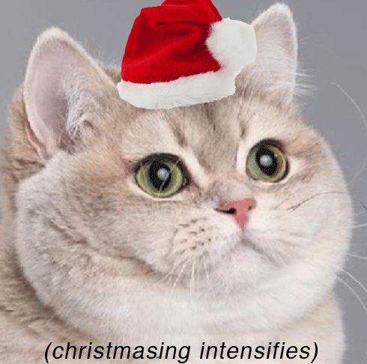
Secret santa sign up!
Sign up for Secret Santa gift
exchange!
Due first meeting back from
winter break! 1/07/2015
We’ll send out emails tonight

Slide 38
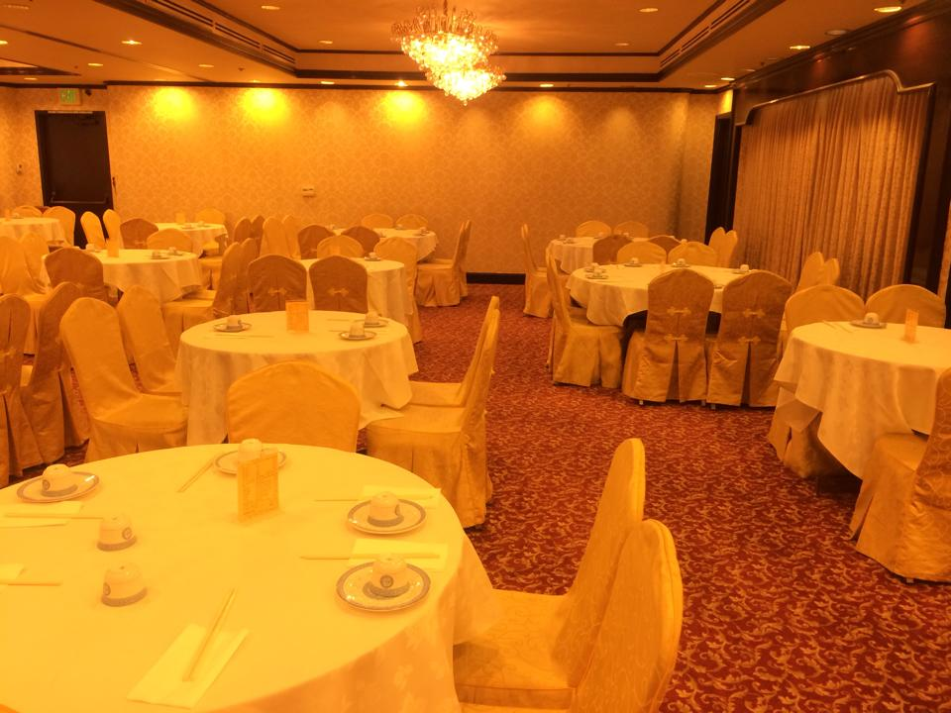
Banquet is coming soon
YAY!!!
Empress Harbor
again!!! since you guys
LOVE IT!!!
$50 EACH

Slide 39
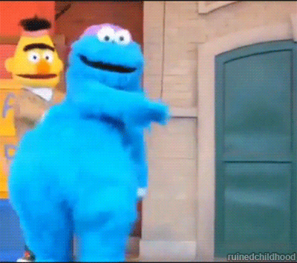
Just Kidding~~~
Vote >> Friday, Saturday, Sunday
Price is more expensive on Saturday Nights

Slide 40
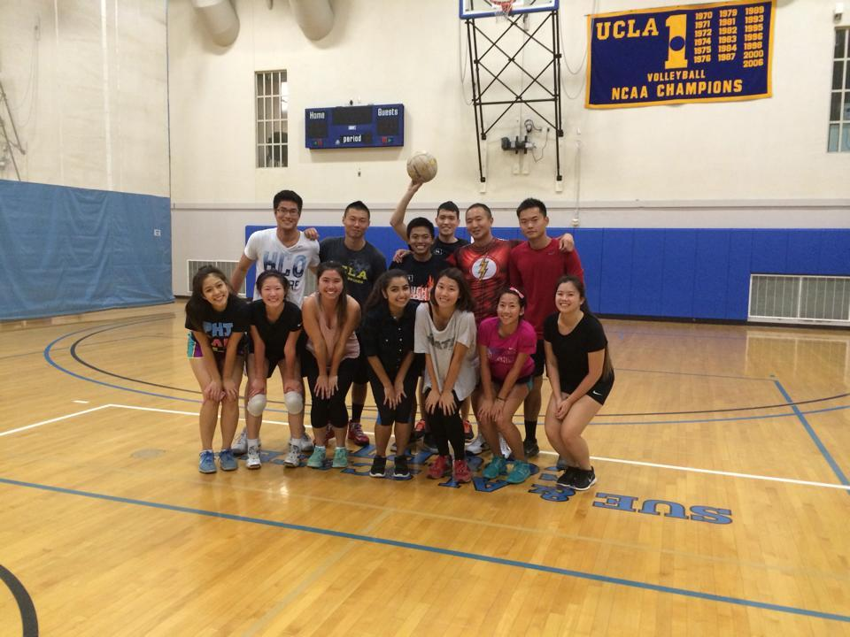

IM Sports
Thanks for supporting us this term!!!! We made playoffs for both Volleyball + Soccer!

Slide 41

NEW EVENTS!!!!
Let us know if you guys want any events during
Winter Break =)

Slide 42

Historian
Juana Li
historian@apo-x.org

Slide 43

Updates
Nominate Brothers for BOTW!
Look out for the next Brothers of Chi Chapter picture!
Thats all, have a good rest of the week! =D

Slide 44
Sergeant-at-Arms
George Hsin
apoxsergeant@gmail.com

Slide 45
Chairing
Email 3 days prior to event
Ex: Friday event, send out email on Tuesday
Text/Call 1 day before
Text before 9PM, Make sure to include all relevant information and INCLUDE YOUR NAME
If no response by 9PM, must call before 10:30PM
*Receiving Chairing Credit
Must follow above guidelines and send in Evaluation
Will only receive credit if rules 1&2 are completed
IMPORTANT: Must send in eval for people to get credit for the event, however no chairing credit will be given

Slide 46

^{Sorry, I had to. - Love, Brian}

Slide 47
Interchapter Chair
Chanel Ng
interchapter@apo-x.org

Slide 48


IC’s in Da House
Welcome Rho Rho!
Hang out with ICs after meeting

Slide 49
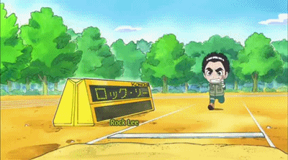
IC Pen Pals
Need 7 more people to sign up!
Jonathan Liu
Elaine Lee
Anne Tan
Andy Thai
Shirley Lin
Nancy Nguyen
Sarah Yi
Lisa Lau
Diane Huynh
Jeesun Youn
Yuki Nakamura
Nicola Yip
Nhat Thai

Slide 50
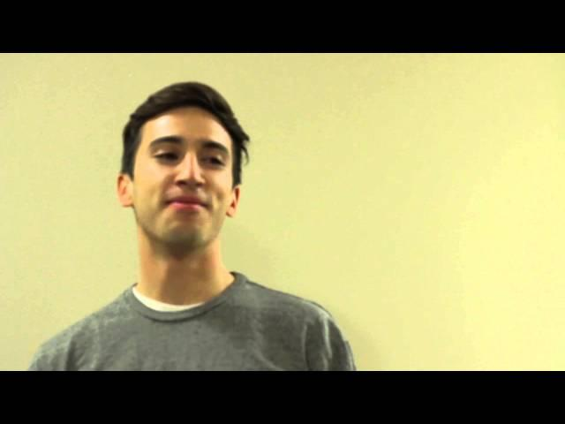
APO National Convention
All registrations and payments due by December 14th!

Slide 51
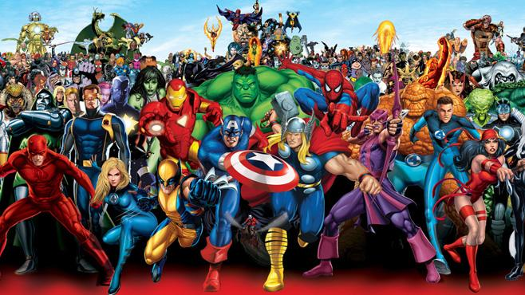
CAC
Paul Choung
cac@apo-x.org

Slide 52

ACS (Josh Chang, Michael Hung, Hazel Jeon, Abram Summers, Irene Tang, Jennifer Wong) will return to our regularly scheduled programming next week.

Slide 53
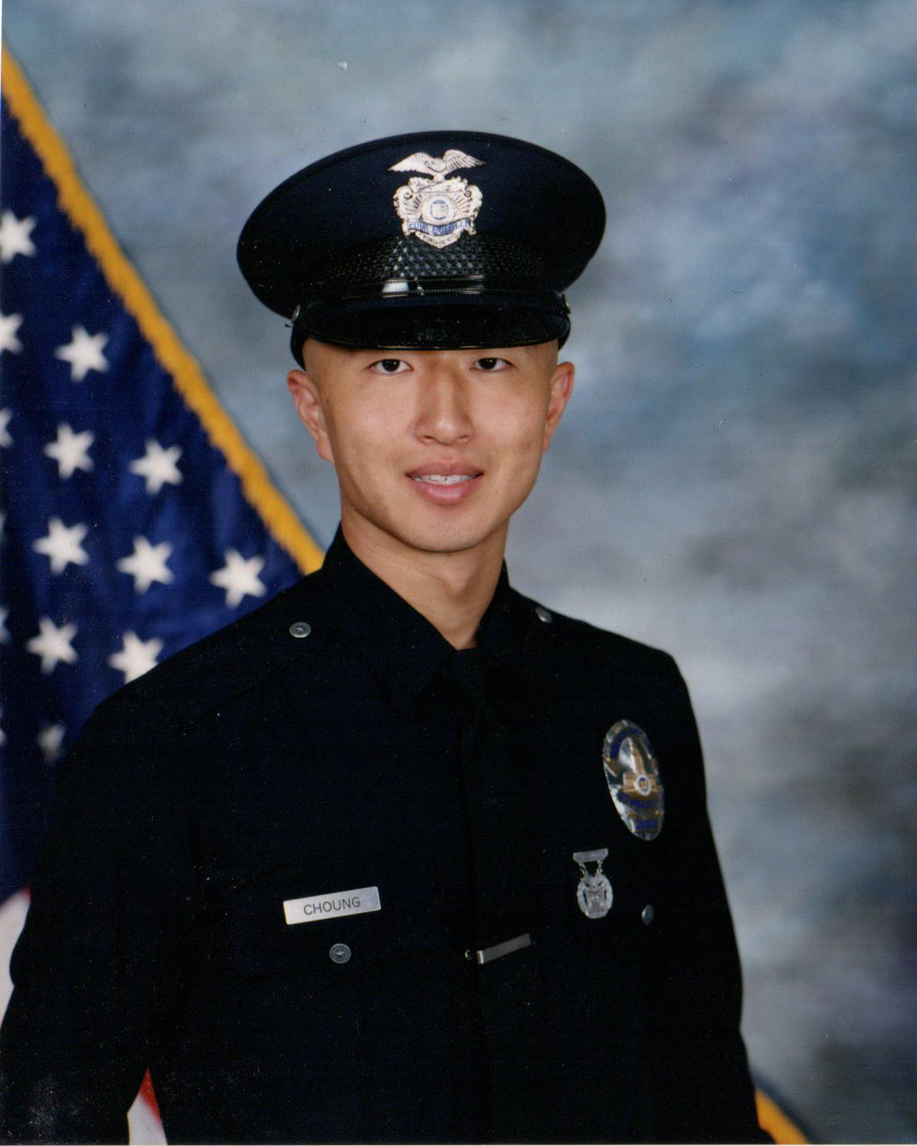
Greetings.

Slide 54
STATE OF THE CHAPTER
OPEN FLOOR DISCUSSION
Safe space
Be mindful of time
Be direct
Thanks!

Slide 55
Nominations
President
Melissa Ma
Brian Lee
Emily Neai-Proeung
Andrew Suh
Jeremy Gozzip
Service VP(s)
Victor Vu & Tina Ngo

Slide 56
Nominations
Membership VP(s)
Josh Chang & Katherine Cardoza
Sharon Yu & Jonathan Pang
Chanel Ng & Rachel Belyea
Vivian Shih & George Hsin
Pledge Parent(s)
Angus Tse & Iris Lam
Abram Summers & Harrison Choi
Jeremy Gozzip & Melissa Ma
William Nguyen & Miye Nakashima
George Hsin & Ann Dai

Slide 57
Nominations
Administrative VP(s)
Nhat Thai & Sandra Huynh
Finance VP(s)
Sheila Wahezi & Thu Mai

Slide 58
Nominations
Fellowship VP(s)
Brian Martin & Sarah Yi
Lucy Diep & Kevin Vu
Vivian Shih & George Hsin
Nhat Thai & Sandra Huynh
Historian
Juana Li
Patricia Natalie
Josh Chang

Slide 59
Nominations
Sergeant-at-Arms
Irene Tang
Kevin Vu
Josh Chang
George Hsin
Miye Nakashima
Interchapter Chair
Lisa Lau
Bowen Lu

Slide 60
Nominations
Chair of the Advisory Committee
Abelard Bautista
Jessica Suhardjo

Slide 61
Advisor Elections
CONGRATULATIONS JESSICA SUHARDJO!!!
Nominations
Olivia Pardo

Slide 62
Alpha Nu - Namesake
NOMINATIONS NEXT WEEK!
OPEN UNTIL CM11! ELECTIONS CM11!
Last two namesakes: Yuna Choi and Anna Lee
For those who have given a lot to CHI CHAPTER

